Slide 1



Speeded-Up Robust Feature Descriptor for chromoENDOscopy Images
Viet Dung Nguyen & Thanh Hien Truong
Hanoi University of Science and Technology, School of Electronics and Telecommunications,
Biomedical Department, Hanoi, Vietnam

Slide 2
Content
Introduction
Proposed Method
Results and Discussion

Slide 3
Introduction
Gastrointestinal cancer has been increasingly found in people of all ages
This disease is one one of the most common types of cancer
Chromoendoscopy (CH) is a less invasive and effective method for diagnosing the gastrointestinal cancer

Slide 4
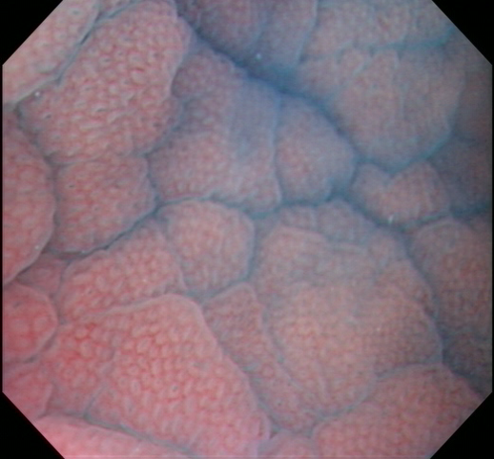
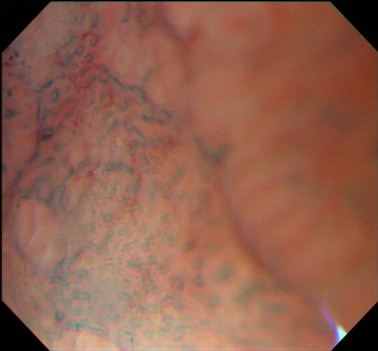
Introduction
Fig. 1. Normal stomach chromoendoscopy (left). Abnormal stomach chromoendoscopy (right)

Slide 5
Challenges
  The diagnosis results also depend on many factors:
    Doctor's experience
    Doctor's status
    Quality of endoscopic images
  ? How to support doctors to improve diagnostic effectiveness?

Slide 6
Proposed Method
Approach to CH image classification problem➔ Based on the features of the CH image
Different feature extraction methods have been applied:
SIFT features
Gabor texture features
LBP features
Features based on Gray Level Difference Matrix (GLDM)
…..

Slide 7
Proposed Method
Images Classification System
Training
Training
images
Extract SURF features
Train SVM model
Model
Extract SURF features
Test
Classified Images
Testing
images
Testing

Slide 8
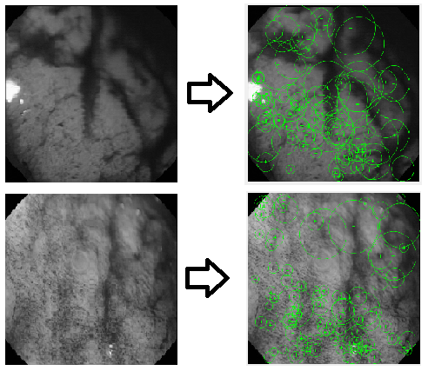
Proposed Method
Fig. 3. 100 strongest SURF features extracted on normal (top) and abnormal (bottom) sample images

Slide 9
Results and Discussion
1. Datasets
The CH images of routine clinical acquisition with Olympus
GIFH180 endoscope at the Portuguese Institute of Oncology (IPO) Porto
28 patients, 4hrs endoscopy videos
176 CH images including 56 normal and 120 abnormal images

Slide 10
Results and Discussion
2. Results
The dataset is randomly divided into training and testing sets with ratio of 70 %:30 % (53 CH images in the testing set, 123 CH images in the training set)
Repeated 100 times, averaged those 100 results
the accuracy and AUC.
Number of selected features | Accuracy (%) | AUC
50 | 78.5% | 0.85
100 | 85.1% | 0.92
1000 | 79.6 % | 0.91
Table 1. Impact of number of selected features on the accuracy and AUC.

Slide 11
Results and Discussion
2. Results
Different classifiers: Classification Tree, K Nearest Neighbors
Compare SURF with KAZE features
Features + Classifier | Accuracy(%) | AUC
SURF+SVM | 85.1% | 0.92
SURF+CT | 66.0% | 0.59
SURF+KNN | 71.7% | 0.79
KAZE+SVM | 81.1% | 0.88
KAZE+CT | 66.7% | 0.62
KAZE+KNN | 71.0% | 0.68
Table 2. Classification results of all the classifiers with the extracted features.

Slide 12
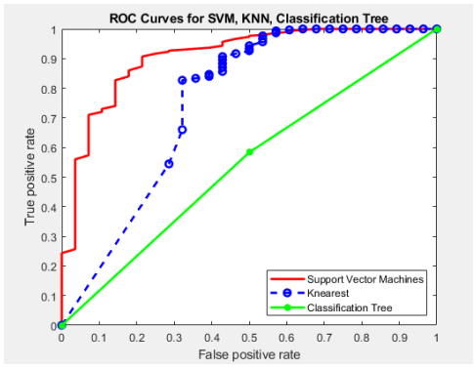
Results and Discussion
Fig. 4. ROC curves of multiple classifiers by using proposed SURF features.

Slide 13
References
[1] H. Bay, A. Ess, T. Tuytelaars and L. Van Gool, “Speeded-up robust features,” Computer Vision and Image
Understanding, vol.110, no.3, pp.346-359, 2008.
[2] K. Onji, S. Yoshida, S. Tanaka, R. Kawase, Y. Takemura, S. Oka, T. Tamaki, B. Raytchev, K. Kaneda, M. Yoshihara, and K. Chayama, “Quantitative analysis of colorectal lesions observed on magnified endoscopy images,” Journal of Gastroenterology, vol. 46, pp. 1382– 1390, 2011, 10.1007/s00535-011-0459-x.
[3] F. Riaz, F. Silva, M. Ribeiro, and M. Coimbra, “Invariant Gabor texture descriptors for classification of gastro enterology images,” IEEE Transactions on Biomedical Engineering, vol. PP, no. 99, p. 1, 2012.
[4] R. Kwitt, N. Vasconcelos, N. Rasiwasia, A. Uhl, B. Davis, M. Hafner, and F. Wrba, “Endoscopic image analysis in semantic space,” Medical Image Analysis, vol. 16, no. 7, pp. 1415 – 1422, 2012.
[5] R. Sousa, D. C. Moura1, M. Dinis-Ribeiro, and M. T. Coimbra1, “Local Self Similar Descriptors: Comparison and Application to Gastroenterology Images”, Conf Proc IEEE Eng Med Biol Soc. 2014; 2014:4635-8.
[6] A. F. Constantinescu, M. Ionescu, I. Rogoveanu, M.E. Ciurea, C.T. Streba, V.F. Iovanescu, S.A. Artene, C.C. Vere, “Analysis of wireless capsule endoscopy images using local binary patterns”, Appl. Med. Inf. 36 (2) (2015) 31.
[7] Hussam Ali, Muhammad Sharif, Mussarat Yasmin and Mubashir Husain Rehmani, “Computer-based classification of chromoendoscopy images using homogeneous texture descriptors”, Computers in Biology and Medicine, vol. 88, 2017, pp. 84–92.
[8] Lowe David G. (1999), "Object recognition from local scale-invariant features", Proceedings of the International Conference on Computer Vision. 2, pp. 1150–1157.
[9] B. E. Boser, I. M. Guyon, and V. N. Vapnik, “A training algorithm for optimal margin classifiers,” in Proc.
of the fifth annual workshop on Computational learning theory, 1992, pp. 144–152
….

Slide 14
Thank you!

Slide 15
Proposed Method
Speeded-up robust features (SURF):
Used in object recognition, image registration, classification or 3D reconstruction.
Based on the Scale Invariant Feature Transform (SIFT)
To detect interest points, SURF uses an integer approximation of the determinant of Hessian blob detector
A fixed number of SURF features must be selected to describe the image

